Slide 1

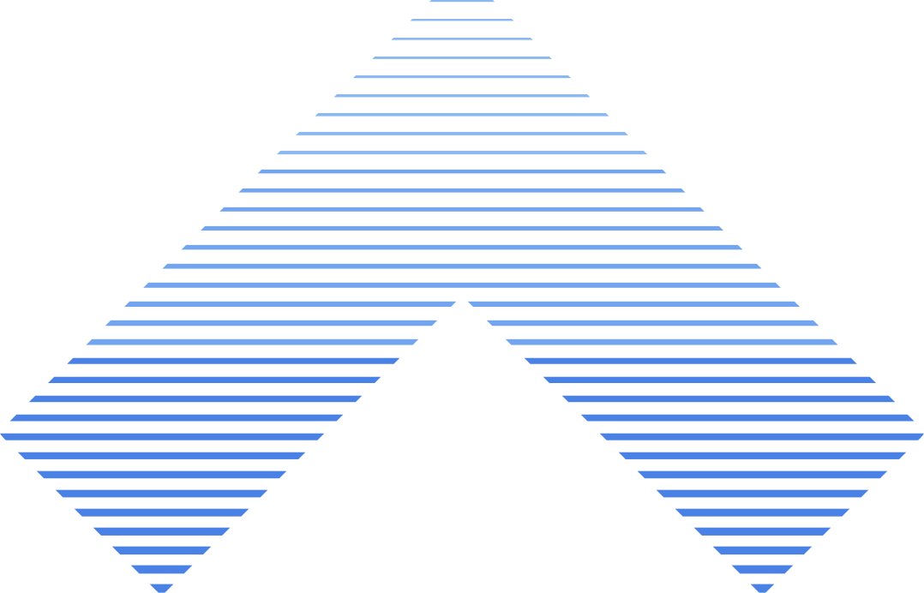

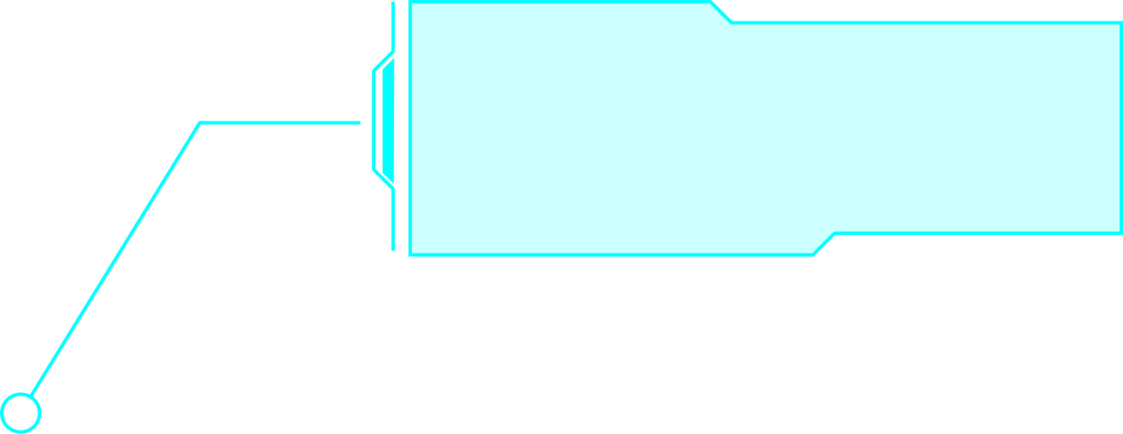
Introduction to
ARRAY IN C

Slide 2

WHAT IS C PROGRAMMING ?
C is a general-purpose programming language developed by Dennis Ritchie in 1972.
It is known as the mother of all programming languages because many modern languages (like C++, Java, Python) are based on C concepts.
C is a high-level programming language that combines the power of low-level programming (close to hardware) with the simplicity of high-level programming, making it widely used for operating systems, compilers, and embedded systems.

Slide 3

An array is a collection of elements of the same data type stored at contiguous memory locations.
Each element can be accessed using an index.
Indexing starts from 0 in C.
WHAT IS ARRAY?

Slide 4
TYPES OF ARRAY
One-Dimensional Array
Two-Dimensional Array
Multi-Dimensional Array
A one-dimensional array is the simplest form of array.
It stores data elements in a linear sequence (like a list).
Each element is accessed by a single index.
Mostly used to store lists of numbers, names, marks, etc.
A two-dimensional array is often called a matrix.
It stores data in rows and columns (tabular form).
Each element is accessed using two indices: row index and column index.
Commonly used in mathematical problems, tables, and games like tic-tac-toe.
An array with more than two dimensions is called a multi-dimensional array.
A 3D array can represent a cube-like structure with rows, columns, and depth.
Higher-dimensional arrays are rarely used directly but useful in advanced applications (e.g., 3D graphics, simulations).

Slide 5
WHY WE USE ARRAYS?
Store multiple values in a single variable.
Easy to access and manipulate data using loops.
Helps manage large amounts of data efficiently.
Useful in algorithms, searching, sorting, and data structures.

Slide 6
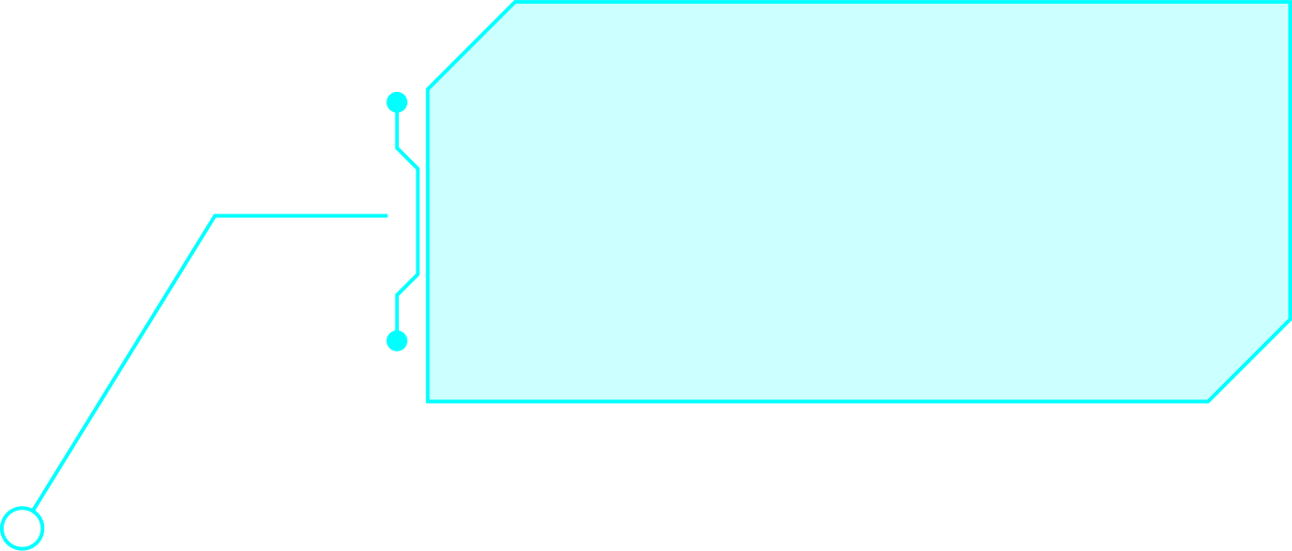
ADVANTAGES & LIMITATIONS
ADVANTAGES
LIMITATIONS
Easy data management
Faster access with index
Simplifies loops
Fixed size (cannot grow/shrink at runtime)
Wastage of memory if not used fully

Slide 7
ONE DIMENSIONAL ARRAY
#include <stdio.h>
#include <conio.h>
voidmain() {
clrscr();
// Declare and initialize an array
int numbers[5] = {10, 20, 30, 40, 50};
// Print array elements
printf("Elements of the array are:\n");
for(int i = 0; i < 5; i++) {
printf("numbers[%d] = %d\n", i, numbers[i]);
}
getch();
}
OUTPUT :
numbers[0] = 10
numbers[1] = 20
numbers[2] = 30
numbers[3] = 40
numbers[4] = 50

Slide 8
TWO DIMENSIONAL ARRAY
#include <stdio.h>
#include <conio.h>
void main() {
clrscr();
int numbers[2][2] = { {10, 20}, {30, 40} };
printf("2D Array Elements:\n");
printf("%d %d\n", numbers[0][0], numbers[0][1]);
printf("%d %d\n", numbers[1][0], numbers[1][1]);
getch();
}
OUTPUT :
2D Array Elements:
10 20
30 40

Slide 9
CONCLUSION
Arrays in C help store and manage multiple values efficiently, making data handling easier.
Despite having a fixed size, they are essential for solving many programming problems.

Slide 10
THANK YOU

